Slide 1
Smart Food Processing and Export Facility
Group Members
Muhammad Shoaib Akhter Qadri
Hafiz Muhammad Hamza
Junaid Nazir
Abdul Mohemin
Adal Imtiaz

Slide 2

Overview:
Modern facility with AI, IoT & automation
Processes fruits, vegetables, packaged foods
Goals: Efficiency, zero waste, global export compliance
Key benefits: Cost savings, traceability, sustainability

Slide 3
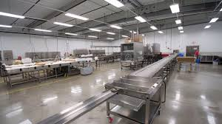
Smart Facility Features
Automated processing lines & conveyor systems
IoT sensors for real-time monitoring
AI for quality control & predictive maintenance
Blockchain for supply chain transparency

Slide 4

Why Fixed Price Contract is Best
Lump-sum payment for clearly defined scope
High cost predictability & budget control
Contractor bears most risks (delays, overruns)
Ideal for standard construction + equipment installation
Common in food processing & export projects

Slide 5
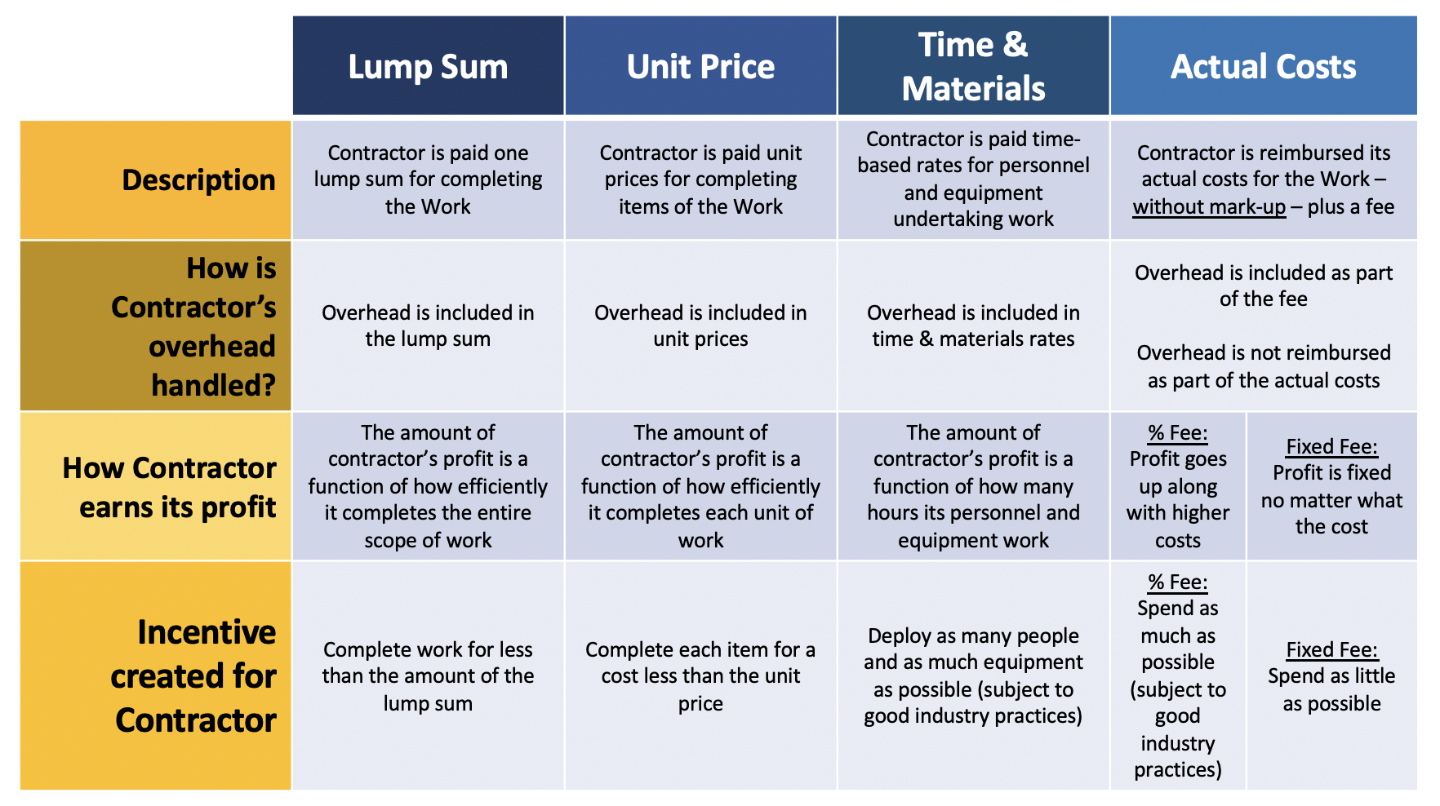

Slide 6
Fixed Price Contract Advantages
Predictable total cost → No surprises
Contractor motivated to finish early & efficiently
Low owner risk & minimal auditing
Fits well-defined specs (HACCP, export standards)
Reduces disputes with clear deliverables

Slide 7
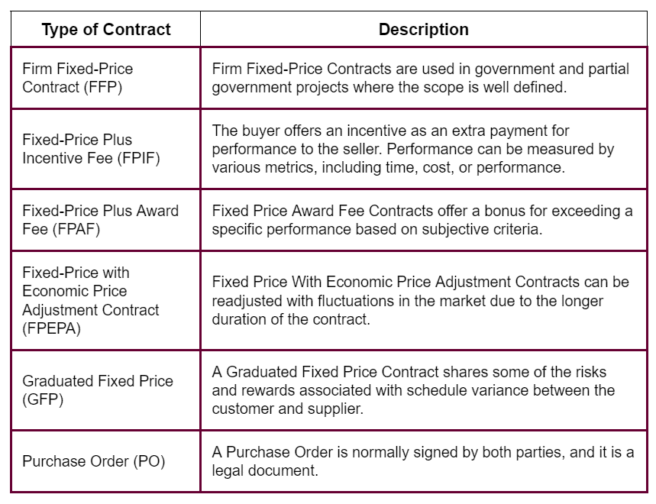

Slide 8
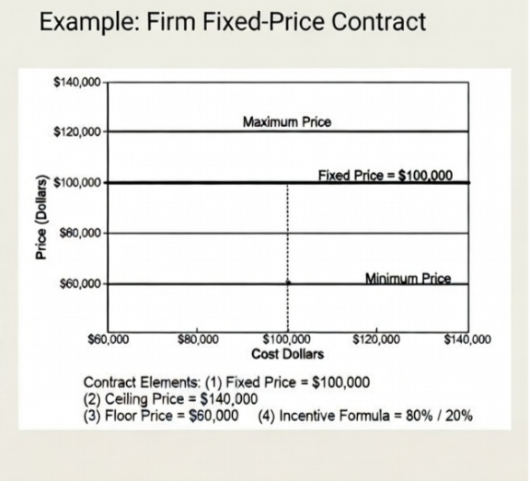

Slide 9
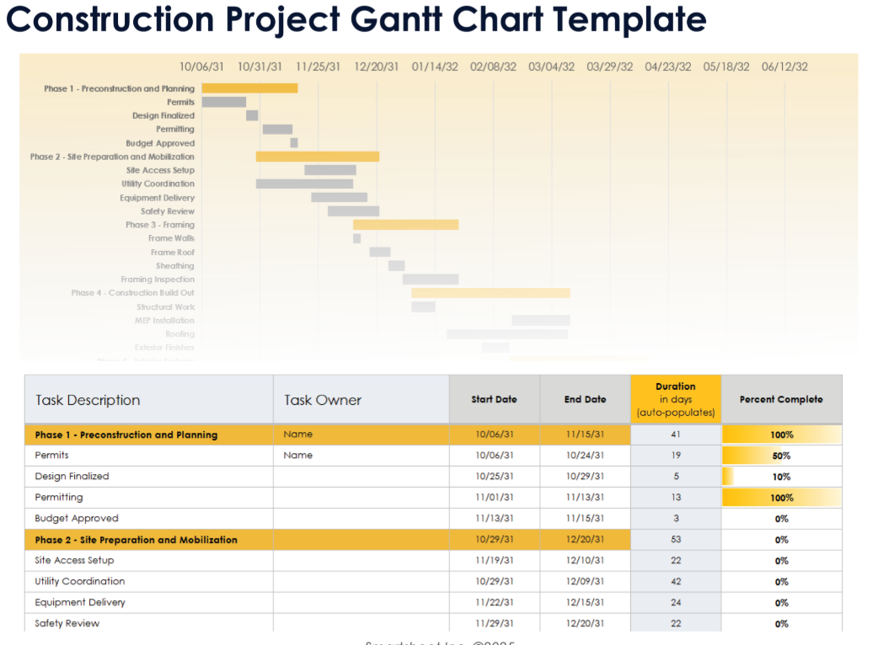

Slide 10
Food Export Supply Chain
Raw materials → Processing → Packaging
Quality checks → Documentation → Certification
Transport → International shipment → Buyers
Smart tech enables full traceability

Slide 11
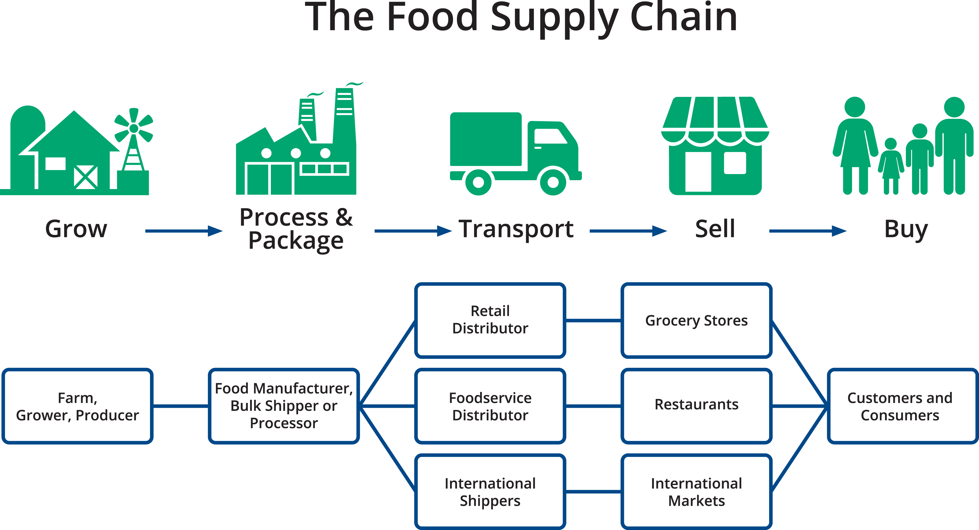

Slide 12
Quick Comparison Table
Contract Type | Risk to Owner | Cost Predictability | Best Fit for Project?
Fixed Price | Low | High | Yes – Recommended
Time & Materials | Medium | Medium | Only for changes
Cost Reimbursement | High | Low | Not suitable

Slide 13
Risks & Mitigation
Risks: Delays, regulatory issues, cost inflation
Detailed specs in RFP
Strong change-order clauses
Competitive bidding
Regular progress reviews

Slide 14
Conclusion
Fixed Price = Best contract for control, predictability & efficiency
Enables fast, compliant, sustainable food export facility

Slide 15
Thank You!

